Slide 1

Health Care Analytics
Team:
Samarth Tyagi
Soutrik Choudhury
Srichand Vishnu
Srikaanth S
Srinidhi SP
Subhranil Roy
Sushanth R

Slide 2
Problem Statement:
To predict the likelihood of a patient to have heart disease.
Key Objectives:
To identify key patterns or features from the dataset.
To Identify and select attributes that are more relevant in relation to heart disease diagnosis.
To interpret and analyze the results of the selected model with the help of domain expert.

Slide 3
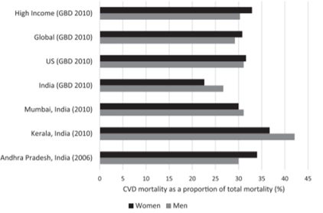
Introduction:
Cardiovascular diseases (CVDs) is the leading cause of mortality in India. Ischemic heart disease and stroke are the predominant causes and are responsible for >80% of CVD deaths.
The Global Burden of Disease study estimate of age-standardized CVD death rate of 272 per 100000 population in India is higher than the global average of 235 per 100000 population.

Slide 4
Data Dictionary:
Age: Age in years Sex: (1 = male; 0 = female) CP: Chest pain type(1-typical angina, 2 - atypical angina, 3 - non-anginal pain, 4 - asymptomatic ) trestbps: Resting blood pressure (in mm Hg on admission to the hospital) Chol: Serum cholestoral in mg/dl Fbs: Indicator of whether fasting blood sugar > 120 mg/dl (1 = true; 0 = false) restecg: Resting electrocardiographic results (0: normal,1: having ST-T wave abnormality (T wave inversions and/or ST elevation or depression of > 0.05mV), 2: showing probable or definite left ventricular hypertrophy by Estes’ criteria) thalach: Maximum heart rate achieved exang: Exercise induced angina (1 = yes; 0 = no) oldpeak: ST depression induced by exercise relative to rest slope: Slope of the peak exercise ST segment (1: upsloping, 2: flat, 3: downsloping) ca: Number of major vessels (0-3) colored by flourosopy thal: Summary of heart condition(3 = normal; 6 = fixed defect; 7 = reversable defect) DV: “The Disease Diagnosis” field refers to the presence of heart disease in the patient(0- No presence,1:Presence)

Slide 5
Data Type of the variable
Age: Factor(28-38:”A”, 38-48:”B”, 48-58:”C”, 58-68:”D”, 68-78:”E”) Sex: Factor CP: Factor trestbps: Numeric Chol: Factor(126-242:”low”, 242-403:”normal”, >403:”high”) Fbs: Factor restecg: Factor thalach: Numeric exang: Factor oldpeak: Numeric slope: Factor ca: Numeric thal: Factor DV: Factor

Slide 6
Variable abbreviation
CP – Chest Pain Type
Levels:
1: typical angina - The presence of substernal chest pain or discomfort that was provoked by exertion or emotional stress and was relieved by rest and/or nitroglycerin 2: atypical angina - One may feel a vague discomfort in one’s chest, experience shortness of breath, feel tired or nauseous, have indigestion, or pain in your back or neck 3: non-anginal pain - Clinical syndrome characterized by discomfort in the chest, jaw, shoulder, back, or arms 4: asymptomatic - If a patient is a carrier for a disease or infection but experience no symptoms.
OLDPEAK
It is significant if it is more than 1 mm in V5-V6, or 1.5 mm in AVF or III.

Slide 7
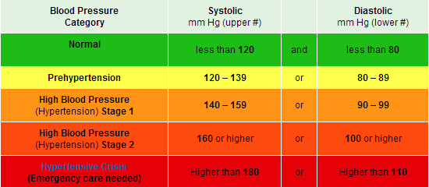
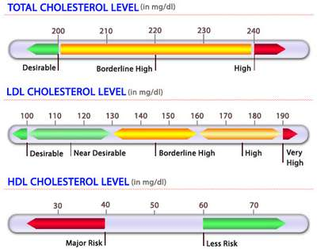
Variable abbreviation
Trestbps – Resting Blood Pressure in mm Hg
on admission to hospital
Chol – Serum cholesterol in mg/dl

Slide 8
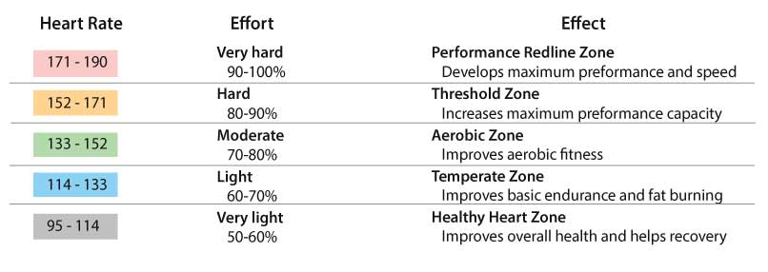
Variable abbreviation
Thalach – Max heart rate achieved

Slide 9
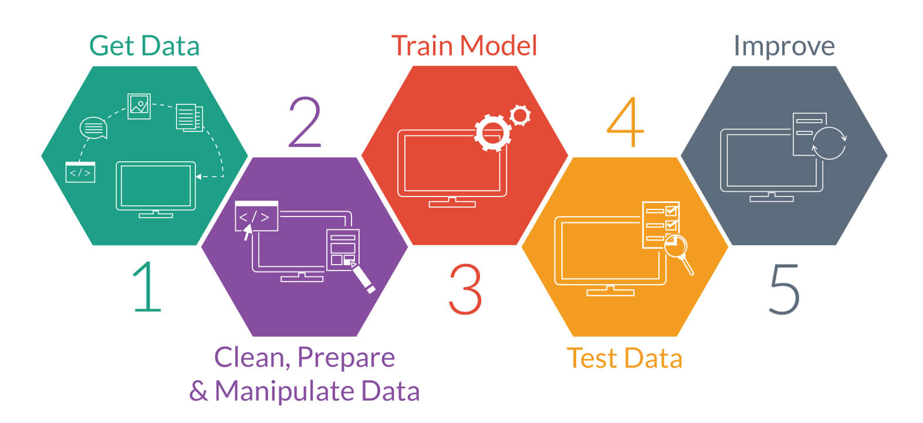
Steps for Predictive Modelling

Slide 10
Comprehensive Approach
1
Data Extraction & Preparation
2
3
Exploratory Data
Analysis
Descriptive Data Analysis
6
5
Model Selection & Application on training dataset
4
Model Prediction
Creating Training and Validation data set
7
Testing the model on the Validation set
8
Prediction & Comparing the results
9
Publishing the Performance Curve & Results

Slide 11
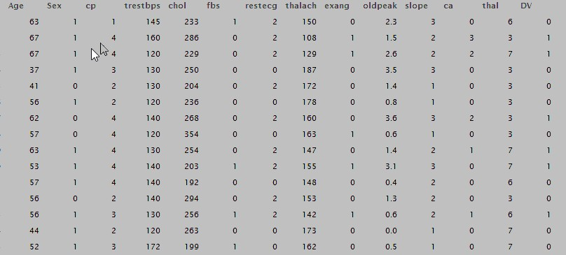
Data Extraction & Preparation

Slide 12
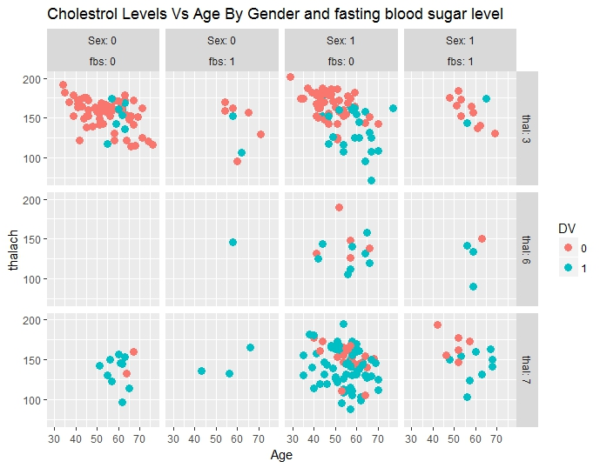
Exploratory Data Analysis Visualization
Legend
Fbs:0 | Normal glucose level (<120 mg/dl)
Fbs:1 | High glucose level (>120 mg/dl)
Thal:3 | Normal Heart Condition
Thal:6 | Fixed Defect
Thal:7 | Reversible Defect
Sex:0 | Female
Sex:1 | Male

Slide 13
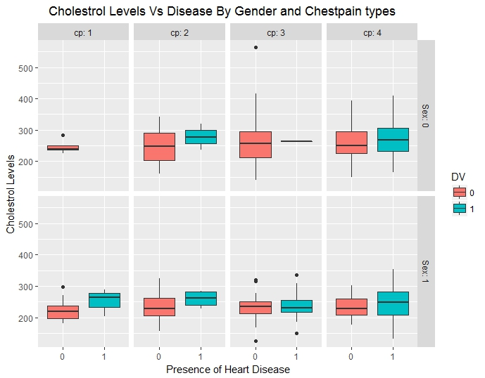
Exploratory Data Analysis Visualization
Legend
Cp:1 | Typical Angina
Cp:2 | Atypical Angina
Cp:3 | Non-anginal Pain
Cp:4 | Asymptomatic
Sex:0 | Female
Sex:1 | Male

Slide 14
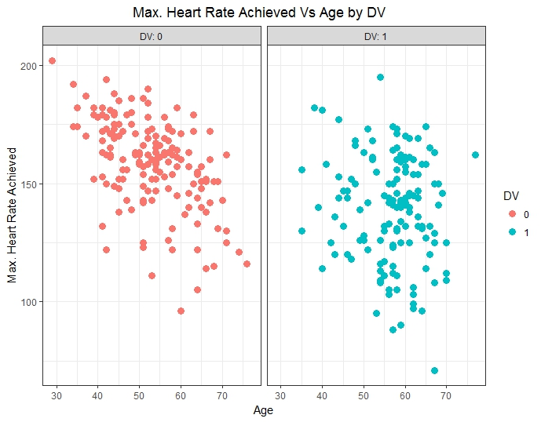
Exploratory Data Analysis Visualization

Slide 15
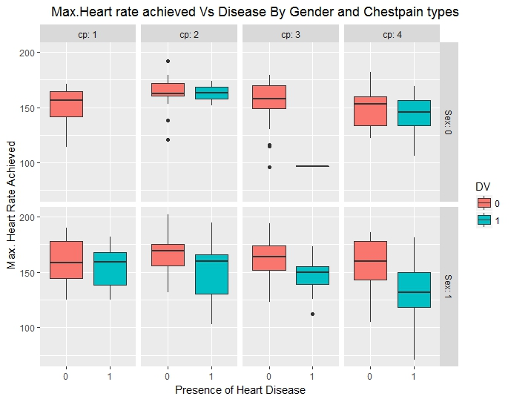
Exploratory Data Analysis Visualization
Legend
Cp:1 | Typical Angina
Cp:2 | Atypical Angina
Cp:3 | Non-anginal Pain
Cp:4 | Asymptomatic
Sex:0 | Female
Sex:1 | Male

Slide 16
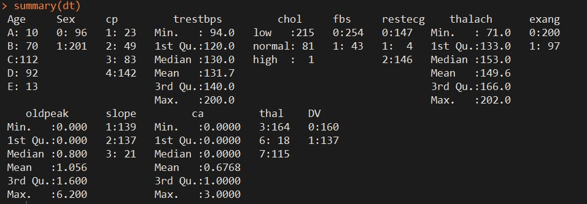
Descriptive Data Analysis

Slide 17
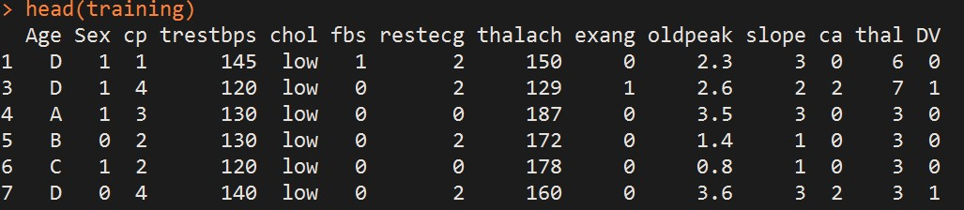
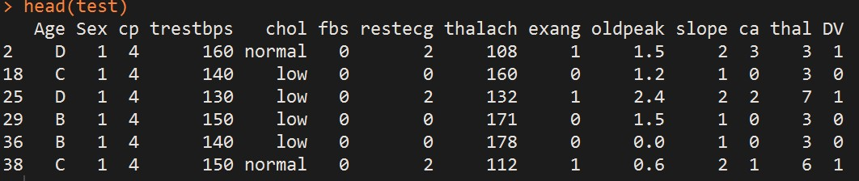
Creating Training and Validation dataset

Slide 18
Model Selection & Application
Classification is a process that is used to find a model that describes and differentiate data classes or concepts, for the purpose of using the model to predict the class of objects whose class label is unknown.
TOOLS FOR CLASSIFICATION:
1. Logistic Regression,
2. Decision tree,
3. Artificial Neural Network and
4. Bayesian Classifier
Logistic Regression is chosen for this prediction because of its simplicity and its accuracy is above 90% on the validation dataset.

Slide 19
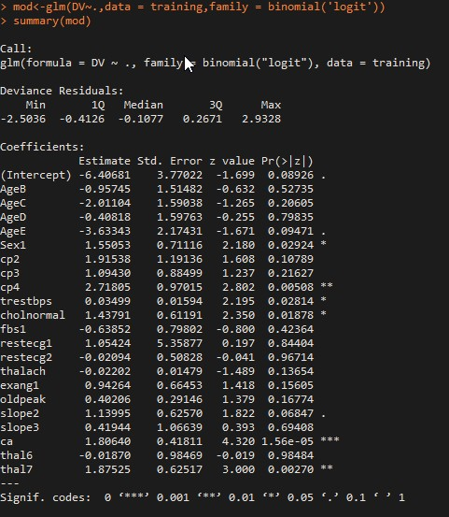
Model Implementation

Slide 20
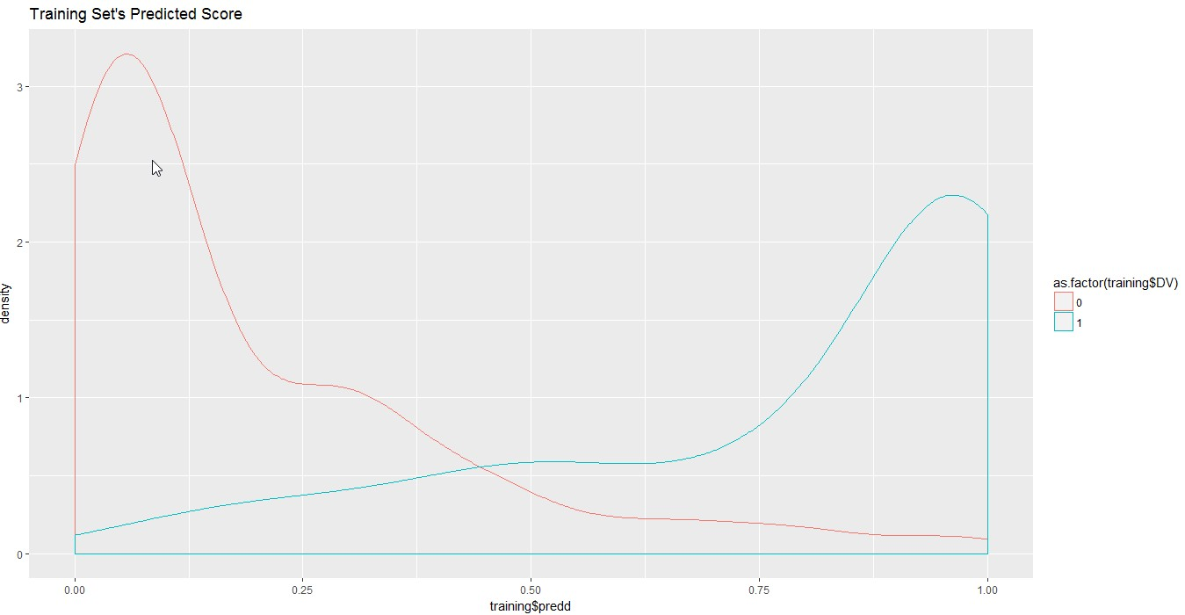
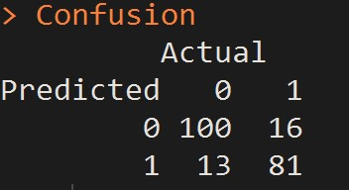
Model Prediction

Slide 21
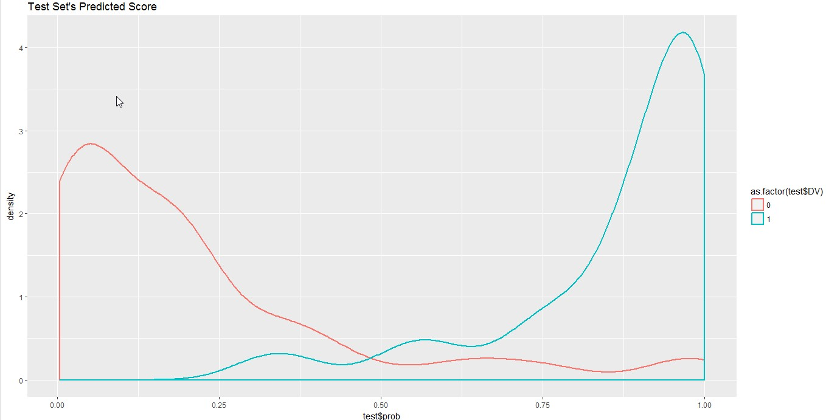
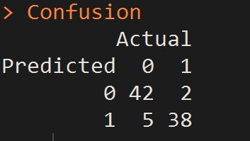
Prediction & Comparing the results

Slide 22
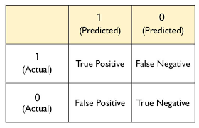
Performance Evaluation
To measure the stability of performance the data is divided into training and testing data with 10-fold cross validation.
Sensitivity = True Positive/ Positive
Specificity = True Negative/ Negative
Accuracy = (True Positive + True Negative) / (Positive + Negative)
Confusion matrix:

Slide 23
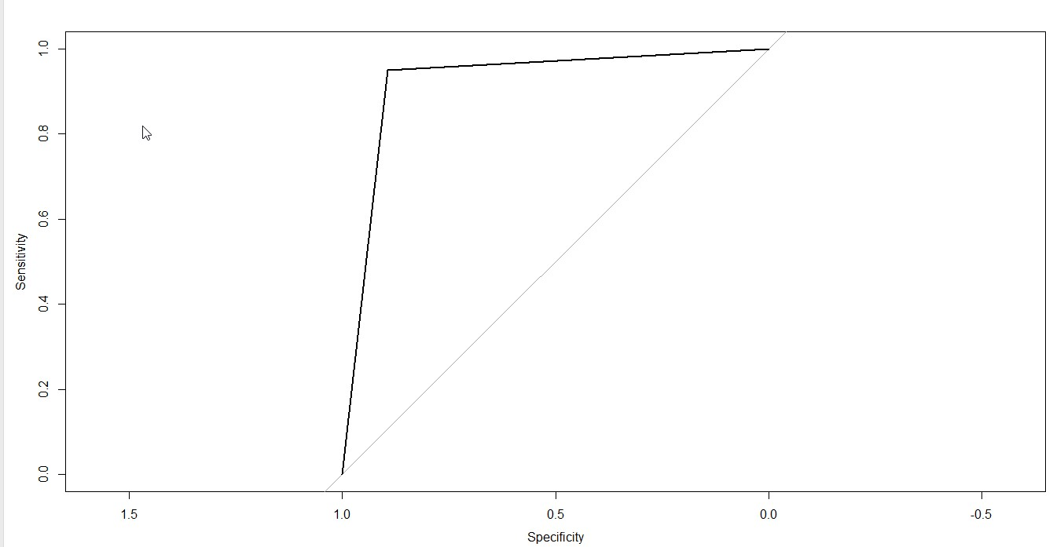
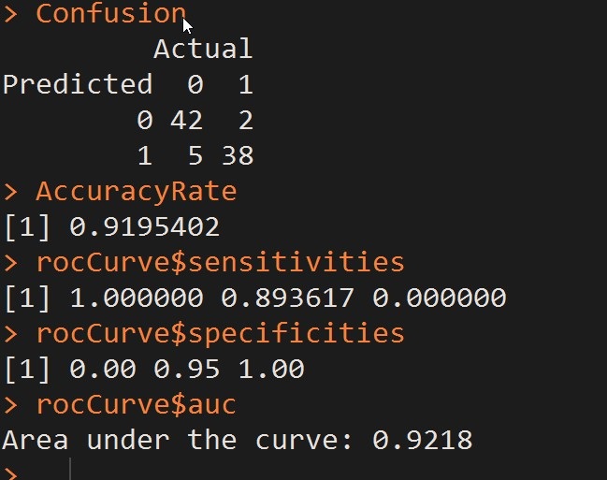
Publishing the Performance Curve & Results

Slide 24
Data Source:
1. Hungarian Institute of Cardiology. Budapest: Andras Janosi, M.D. 2. University Hospital, Zurich, Switzerland: William Steinbrunn, M.D. 3. University Hospital, Basel, Switzerland: Matthias Pfisterer, M.D. 4. V.A. Medical Center, Long Beach and Cleveland Clinic Foundation: Robert Detrano, M.D., Ph.D.
Github Repository:
https://gist.github.com/soutrik7771/197edc79e6af0ee41d32e42bd5b684cb

